Slide 1
Category review: Chips
September 2024
Retail Analytics
Brand note: If client logo is not required, use alternate title page layout right click slide thumbnail > Layout > Title

Slide 2
Notes:
To view Privacy video explaining how important data privacy is to Quantium, please click here: https://www.youtube.com/watch?v=Zq1QDAkoRzU
or here Q:\Company Reference\Brand & Design\Brand videos\Q Privacy.mp4
At Quantium, we believe that data is the behavioural footprint of humanity and that it has to be treated with the utmost care and responsibility.
Histories, attitudes, indeed lives are stored within it in ways that aren’t always apparent – and that’s what makes its potential so powerful.
To work with it responsibly, sensitively, we set ourselves the highest data privacy protection and governance standards.
We have spent 17 years perfecting privacy-by-design and secure-by-design principles. Central to this is not holding any personally identifiable information about people –
we neither receive it, and put the necessary protections in place to be unable to decipher it.
Every aspect of handling data is safeguarded: from its de-identification, to its encryption – data security is paramount and of the highest grade.
We pride ourselves on gaining the trust of iconic organisations around the world through years of securely working with their data,
and in turn the trust that builds with their stakeholders.

Slide 3
Executive summary
Comparison of chip sales overtime from 2018 to 2019
Impact of customer affluence on spending habits
Impact of customer life stage and affluence on spending habits
01
Task 1
Overview of chip sale and key information
Trial store vs control store during trial period
Trends in trial store vs control store
Trial store performance before, during, and after trial period
02
Task 2
Performance analysis of trial versus control stores

Slide 4
01
Overview of chip sale and key information

Slide 5
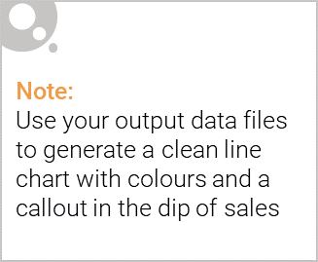
TOTAL SALES TREND ACROSS THE YEARS
Total sales in Q3 and Q4 of 2018 were significantly higher than in Q1 and Q2 of 2019, with a slight improvement observed in June 2019.

Slide 6

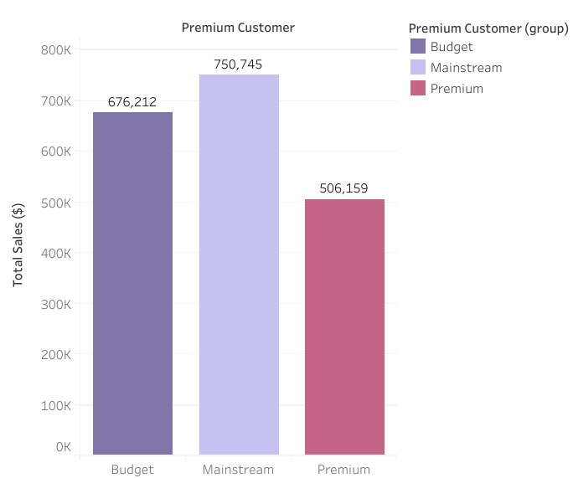
IMPACT OF CUSTOMER AFFLUENCE ON SPENDING HABITS
Mainstream customers accounted for the majority of chip purchases, followed by budget customers.
Affluence, however, had no significant impact as expected, since the higher spending by mainstream
customers was due to their larger numbers compared to other buyer groups.

Slide 7
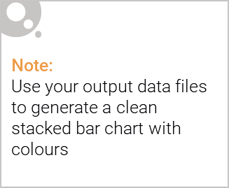
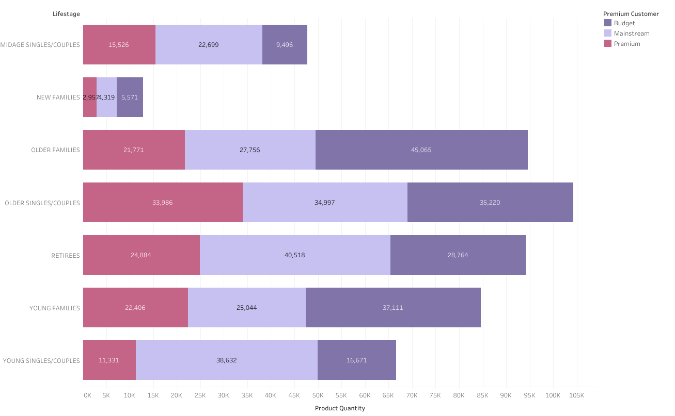
Editable (delete this)
IMPACT OF CUSTOMER LIFE STAGE AND AFFLUENCE ON SPENDING HABITS
The data shows that older singles, couples, and retirees tend to purchase more chips. However,
mainstream, middle-aged and young singles/couples are more likely to pay more per packet, indicating
impulse buying behavior.

Slide 8
02
Trial store performance

Slide 9
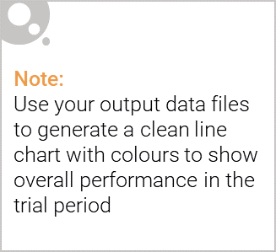
TRIAL STORE VS CONTROL STORE DURING TRIAL PERIOD
Overall, the trial stores showed a significant increase in sales compared to the control stores.
The trial stores experienced a steady rise in sales starting in February, followed by a slight decline in
April. The total number of customers during the trial period was significantly higher in the trial stores
than in the control stores for two out of the three months.

Slide 10
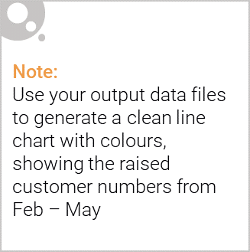
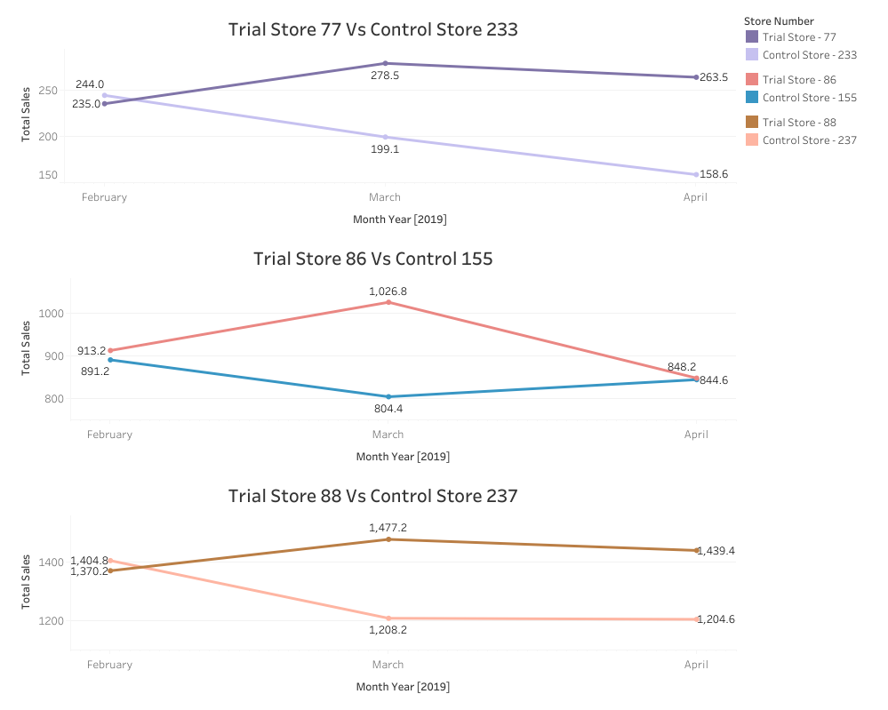
TRENDS IN TRIAL STORE VS CONTROL STORE
The steady increase in sales, beginning in February and ending with a slight decline in April, was
consistent across all trial stores. The positive trial effect is evident, as the total number of customers
during the trial period was significantly higher in the trial stores compared to the control stores for two out
of the three months.

Slide 11
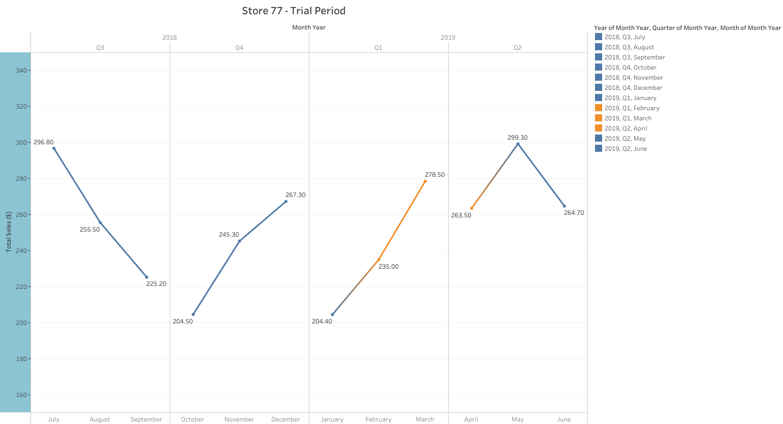
TRIAL STORE PERFORMANCE BEFORE, DURING, AND AFTER TRIAL PERIOD
For store 77, sales increased during the trial period, followed by a slight decline in April. After the trial period,
the store maintained a higher level of sales.

Slide 12
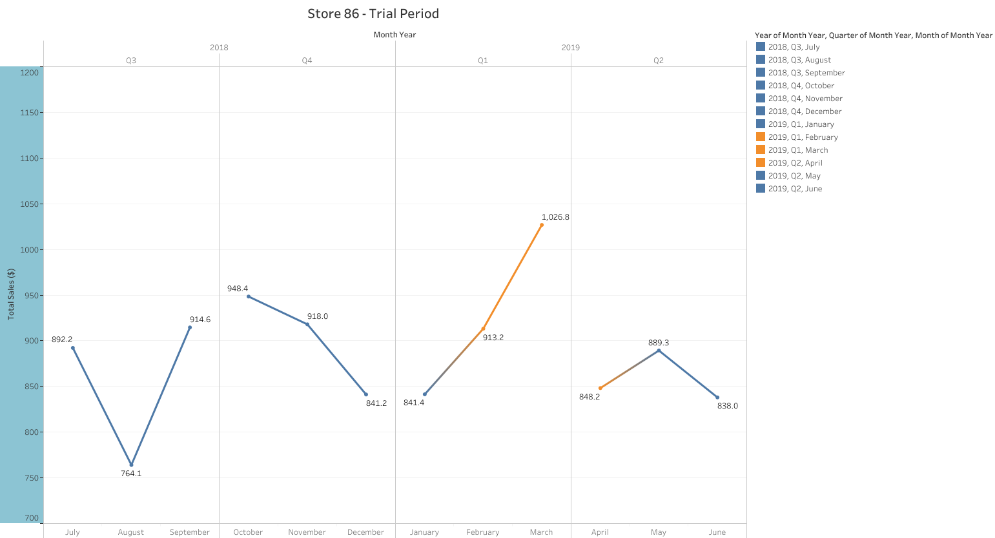
TRIAL STORE PERFORMANCE BEFORE, DURING, AND AFTER TRIAL PERIOD
For store 86, sales increased during the trial period, with a significant rise in March and a decline in April.
After the trial period, sales returned to their previous levels.

Slide 13
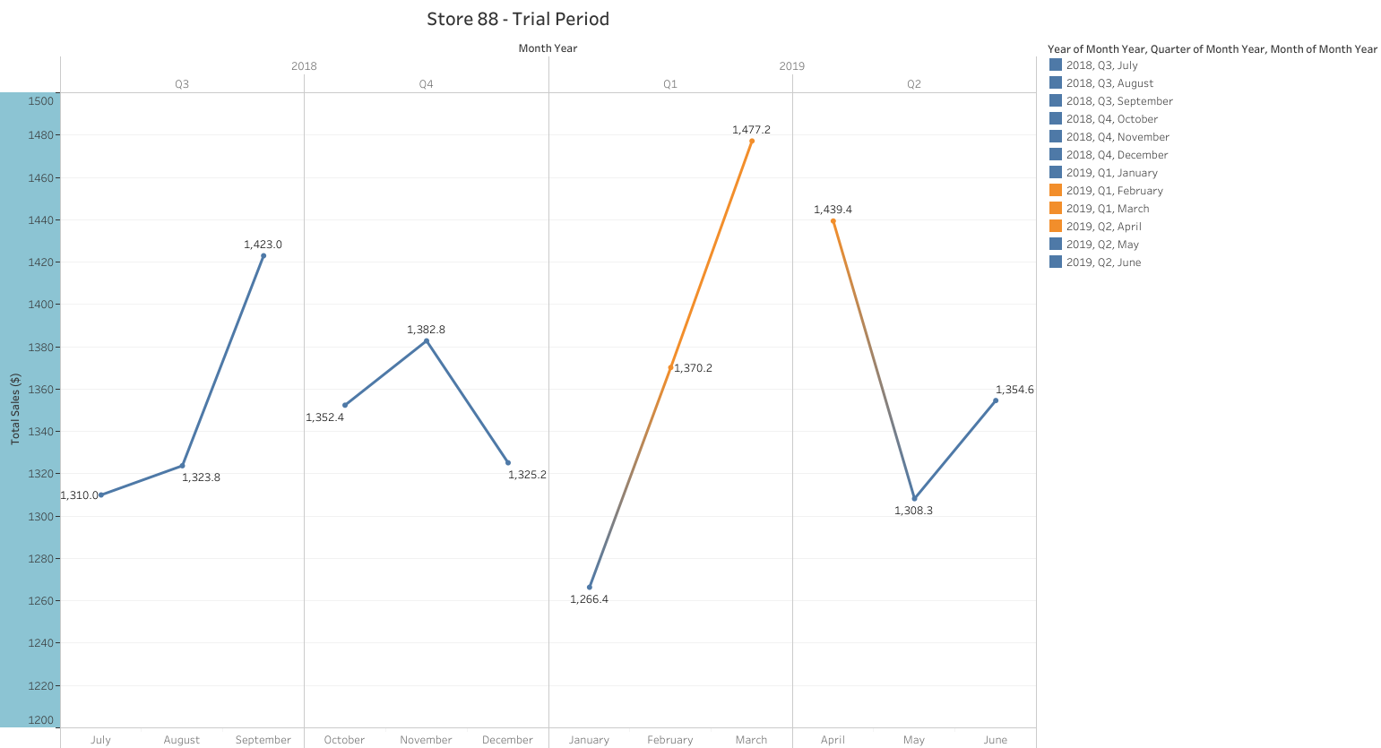
TRIAL STORE PERFORMANCE BEFORE, DURING, AND AFTER TRIAL PERIOD
For store 88, sales increased during the trial period, with a slight decline in April. After the trial period,
sales dropped significantly.

Slide 14
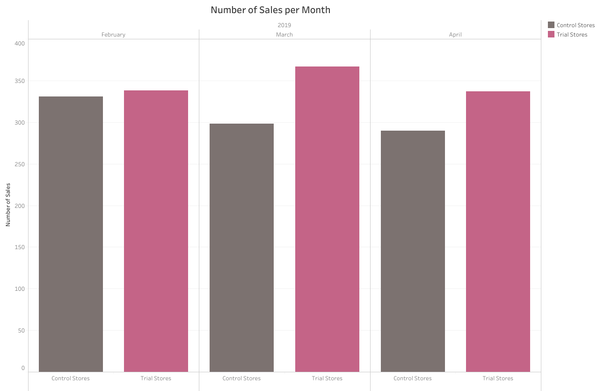
CONCLUSIONS
The positive trial effect can be
summarized by the significantly higher
number of customers in the trial stores
compared to the control stores for two out
of the three months.
Store 77 showed a positive change in
consumer purchasing behavior after the
trial period, while the other two trial stores,
86 and 88, reverted to their original sales
levels.
In conclusion, we recommend implementing
the actions carried out in the trial stores
during the trial period across all other stores.
A follow-up study should be conducted to
assess the impact of these new actions on
the stores.

